Slide 1
Functional Programming
One of the most useful things that you may never use

Slide 2
Characteristics of Procedural Programming
Very command driven (imperative)
“Go here, then go there, then do that”
Memory management is typically very manual
“Feels like” it shares design with the hardware

Slide 3
Leibniz (1646-1716)
Create a “universal language” to state all problems
Find a method to solve problems in that language
…
Profit
The only way to rectify our reasonings is to make them as tangible as those of the Mathematicians, so that we can find our error at a glance, and when there are disputes among persons, we can simply say: Let us calculate, without further ado, to see who is right.[

Slide 4
Two different approaches to solving this
Alan Turing invented Turing Machines and defined computation using these machines
Alonzo Church invented lambda calculus and defined functions computation

Slide 5
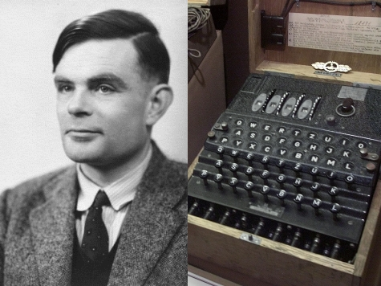
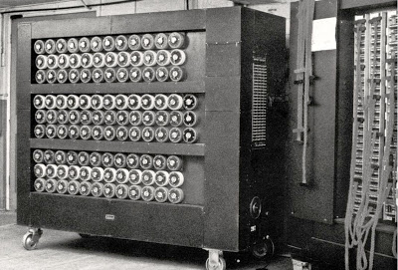
Alan Turing

Slide 6
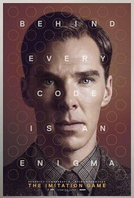
The Imitation Game
Entertaining but (mostly) good history of Computer Science

Slide 7
Turing spent WW II cracking German encryption codes using a mechanical computer HE DESIGNED!

Slide 8
Turing and Von Neumann (and others) realized that a general purpose computing machine would be amazingly valuable
But how?

Slide 9
Much of this work was classified because of the contributions to the war effort. But a few papers were published…

Slide 10
The Turing Machine
Table of Instructions
Read/Write Head
“Enough” Paper Tape

Slide 11


Slide 12
Read 2 “1’s” - binary digits
State Number | If read 0, then go to state | If 1 this go to state | Comment
A | A | B | Total = 0
B | B | C | Total = 1
C | C | D | Total = 2
HALT

Slide 13
Seems Pretty Useless, huh?

Slide 14
As powerful as any computer today!

Slide 15
Because everything in today’s computers breaks down to the same concepts – read memory, write memory, change the instruction the CPU is looking at

Slide 16
A language is said to be Turing Complete if it can solve any problem that a Turing Machine can solve

Slide 17
A conditional (go to state N when the tape is 0/1)
The ability to read memory (“the read head”)
The ability to change state (“the write head”)

Slide 18
The language that a simple calculator uses is not Turing Complete (no conditionals)

Slide 19
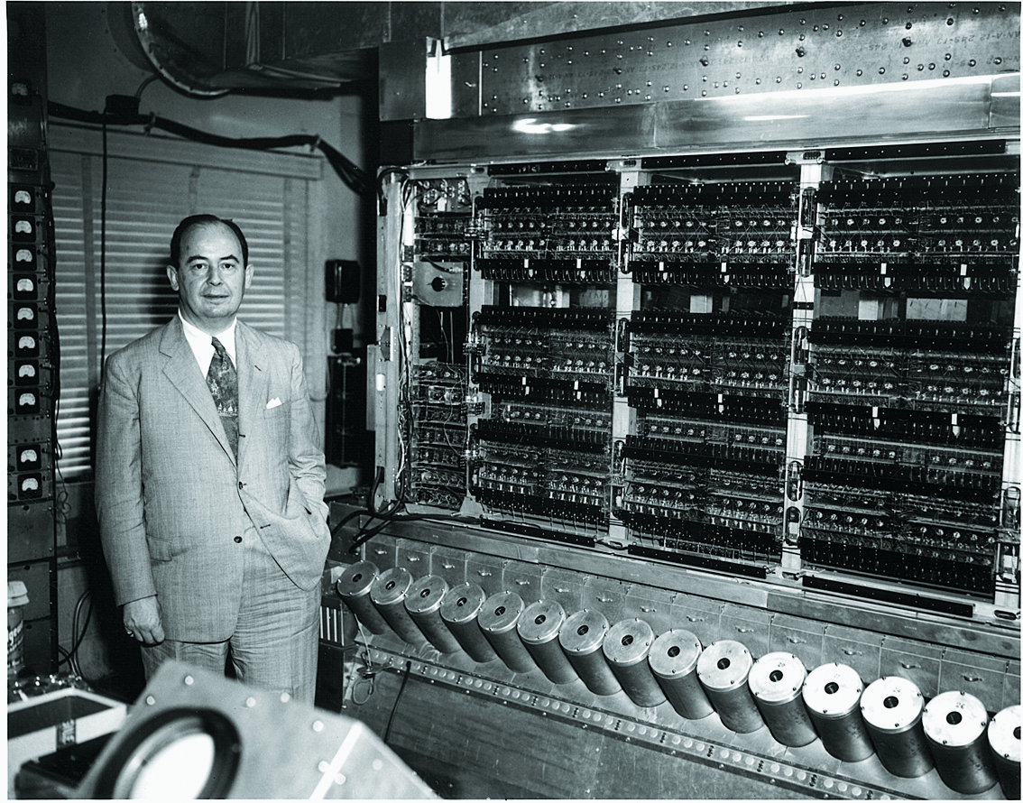
John Von Neumann

Slide 20
Probably the most influential mathematician of modern times.
Invented game theory.
Invented the math for Quantum Mechanics.
Worked on the A Bomb!
Proponent of M.A.D.

Slide 21
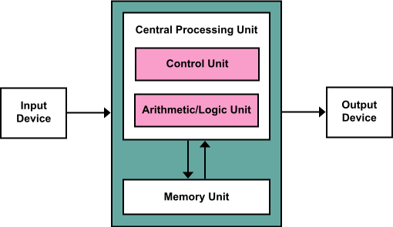
Because of this:
The Von Neumann Architecture

Slide 22
Von Neumann looked at what Turing said and added the idea that the “table of states” or program could be stored on the same “paper tape” as the data.

Slide 23
Is this still relevant today?

Slide 24
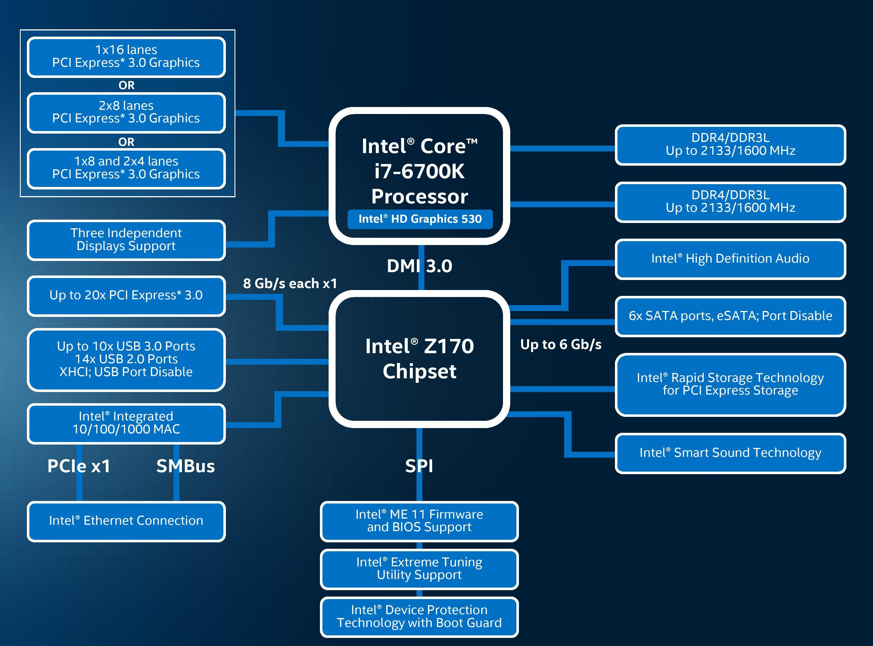
Memory
I/O
I/O
ROM

Slide 25
Procedural Languages – Turing/Von Neumann
Procedural (and Object Oriented) languages follow this paradigm
We have “state” – the paper tape – and we have programs that manipulate the state of the paper tape (memory).

Slide 26
Let’s get back to Alonzo Church
He was Alan Turing’s doctoral advisor!
Taught at Princeton for nearly 40 years.
He was a mathematician, not a hardware designer
Solved the universal language problem differently.

Slide 27
A brief intro to Lambda Calculus
A program consists of a single expression, let’s call it E.
Instead of “running a program”, the idea is to perform transformations on the functions based on new information available. One example of new information is that a function was called with a parameter. That allows us to transform the function into a new version of the function without that variable.
f(x) = x+1
f(1) => 1 + 1 => 2

Slide 28
A bigger example:
first of (sort (append('dog','rabbit') (sort ('mouse','cat'))))
first of (sort (append('dog','rabbit')('cat','mouse')))
first of (sort ('dog','rabbit','cat','mouse'))
first of ('cat','dog','mouse','rabbit')
‘cat’
The process of applying these rewrite rules in this way is called “reduction”.

Slide 29
Application and Abstraction
Each function can be applied to data. We saw this with sort, append and first-of.
We consider each function abstracted when it requires one or more value (parameter) to be calculated.

Slide 30
Wait – isn’t this just functions (from math)?
In ordinary math, we have a function like this:
f(x) = 3*x
Church had the idea that we should have a notation for function definition:
f = λx.3*x
(I read this as f is a function depending on x that is calculated by 3*x)
The difference? The function is an entity that stands on its own.

Slide 31
Function composition
You probably remember this from high school:
(f◦g)(x) = f(g(x))
We can state this in λ-calculus:
f◦g = λx.f(g(x))
But, what if you realize that ◦ is a function that takes two functions and returns a function? ◦ = λf. λg. λx.f(g(x))
There are a number of important concepts here!

Slide 32
More Vocabulary
λx.x+y : x is a bound variable – it is substituted when the function is evaluated
y is a free (or unbound) variable – it is NOT substituted
A combinator is a function that has no free variables.
Currying – convert a function with multiple arguments into one argument

Slide 33
More on currying
If I have some function:
f(a,b) ➔ c
I can convert this into two functions.
g(a) ➔ h(b)➔c
function g take a and returns a function that take b and returns c

Slide 34
Partial Application
Looks like currying, very different!
If I have a function + (x,y)
I can make a new function increment:
increment(a) ➔ a + 1
I am applying part of the + function, returning a new function that only takes 1 parameter.

Slide 35
End of Theory – Into the Concrete
First-class functions – the idea that we can have a variable that represents a function. We can pass them to other functions.
Higher order functions – functions that take functions as parameters
Pure Functions – no side effects (no globals)

Slide 36
Where does this all get us?
Functional programming, in its purest form, has no global variables, nothing remembered. It is a calculating machine. That doesn’t make it overly simple or trivial.
Functional and procedural are equally powerful – they solve the same problems, just with a very different approach.

Slide 37
We write our programs differently
Instead of updating variables, we focus on calling functions and passing their return values to other functions.
What advantages are there?
Without globals, each “run” of our program is reproducible.
Without globals, we can split computation to many CPUs more easily.

Slide 38
How do we represent data?
Instead of setting variables, we pass values around.
Instead of an object, we make a list with elements in order.
Instead of modifying a variable, we make a new one.

Slide 39
Java
Functional Language Pseudocode
public class person {
public string name;
public int age;
public person (string s, int a) {
name=s;age=a; }
public void nextYear() {
age = age + 1;
}
}
(define makeStudent (s a) ‘(s a))
(nextYear(s)
(append (firstOf s)
(+ 1 (secondOf s))))

Slide 40
What’s up with all of the parenthesis?
Many of the functional languages use this representation.
Everything is an “S expression” – a list inside parenthesis.
Quoted s-expressions are data. Unquoted are code.
This is one of the syntax issues that students struggle most with.
function(a,b) in Java ➔ (function a b) in Lisp/Scheme

Slide 41
Memory Management
Functional languages offer automatic memory management (like Java). This is particularly interesting, since it was a part of Lisp in the 1950’s. Other languages (mostly) did not adopt it until the 1990’s.
McCarthy’s original algorithm was a “stop the world” – a certain amount of memory is available. When that it gone, the system goes looking for memory that is not in use anywhere and marks it as free. When complete, the free memory becomes the “amount of memory that is available”.

Slide 42
Closures
Consider:
function getIncrementer() {
int x=5;
function f = {
x++;
};
return f;
}
What is the scope of x? What happens if I call f when this function is not running?

Slide 43
Closures
When the function is created, a “closure” is made. Instead of just returning the reference to the function, space is allocated for the variables needed for the function to run. The function and the space are bound together and returned (but it still looks just like a function).
Now when the function is called, it has space for the variable and everything functions the way that you would expect.
Note – Java, C# and others use closure-like techniques, but not closures.

Slide 44
Lazy Evaluation
Idea – don’t evaluate an expression until you need it.
Value – I can express my code in the way that makes the most sense to me, knowing that only as much as necessary will be executed.
Optimizers in compiled code do much of this same work. But functional languages are interpreted, typically, not compiled.

Slide 45
Java (and others) have adopted some of this!
Lambda functions (named after lambda calculus)
Streams (convert a collection to a stream)
Higher order functions

Slide 46
Comparator
static class StudentSortingComparator implements Comparator<Student> {
@Override
public int compare(Student s1, Student s2) {
int NameCompare = s1.getName().compareTo(s2.getName());
if (NameCompare !=0) return NameCompare;
return s1.getAge().CompareTo(s2.getAge());
}
}
Collections.sort(students,new StudentSortingComparator());
students.sort((a,b) ->
if (a.getName().equals(b.getName())
return Integer.compare(a.getAge(),b.getAge())
else
return a.getName().compareTo(b.getName()));

Slide 47
Predicates and Functions
Predicate<type> name = (arg) -> expression; //always return Boolean
Example: Predicate<String> isEmpty = (s) -> s.length()==0;
Boolean nothing = isEmpty(“”);
Function<inType, outType> name = (a) -> expression; // return outType
Example: Function<String, Boolean> isEmpty = (s) -> s.length() == 0;
Boolean nothing = isEmpty(“”);

Slide 48
Suppliers, Consumers
Supplier<type> name = expression; // no args, returns type
Example:
Supplier<Integer> fives = () -> 5;
System.out.println(fives());
Consumer<type> name = (a) -> statement; // no return type
Example:
Consumer<Integer> printIt = (a)-> System.out.println(a);

Slide 49
Streams
List<string> strings = new ArrayList<>();
strings.add(“world”);
strings.add(“hello”);
string.stream() // gives me a stream

Slide 50
Filter, Sorted, ForEach
strings
.stream()
.filter((x) => x.length()>2)
.sorted()
.forEach(System.out::println);

Slide 51
Map, Reduce
int totalLength =
strings
.stream()
.map((x)->x.length())
.reduce(0,(total,element) -> total + element);
int average = totalLength/strings.count();

Slide 52
Match
strings.stream().anyMatch((x) -> x.equals(“nomatch”)); // returns false
strings.stream().allMatch((x) -> x.equals(“nomatch”)); // returns false
strings.stream().noneMatch((x) -> x.equals(“nomatch”)); // returns true

